Slide 1



AERIAL PERSPECTIVE artist’s rendering
FOR TRAINING PURPOSES ONLY

Slide 2
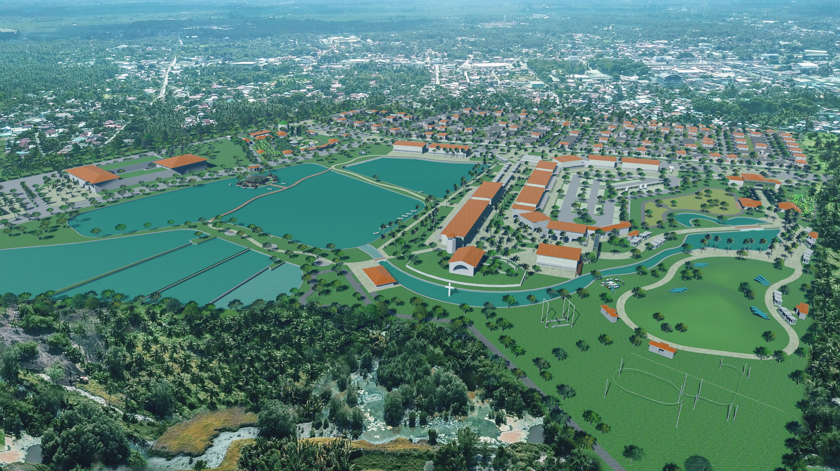
FOR TRAINING PURPOSES ONLY
AERIAL PERSPECTIVE artist’s rendering
With our beginnings deeply rooted in the City of Panabo, Mindanao’s leading
homegrown real estate developer, Damosa Land will be establishing an AGROPOLIS (Agricultural Metropolis, the first master planned Agri-Tourism development in the Davao region which hopes to create a world class environment for generations of Mindanaoans.
Phase 1
* As designed by PGAA

Slide 3
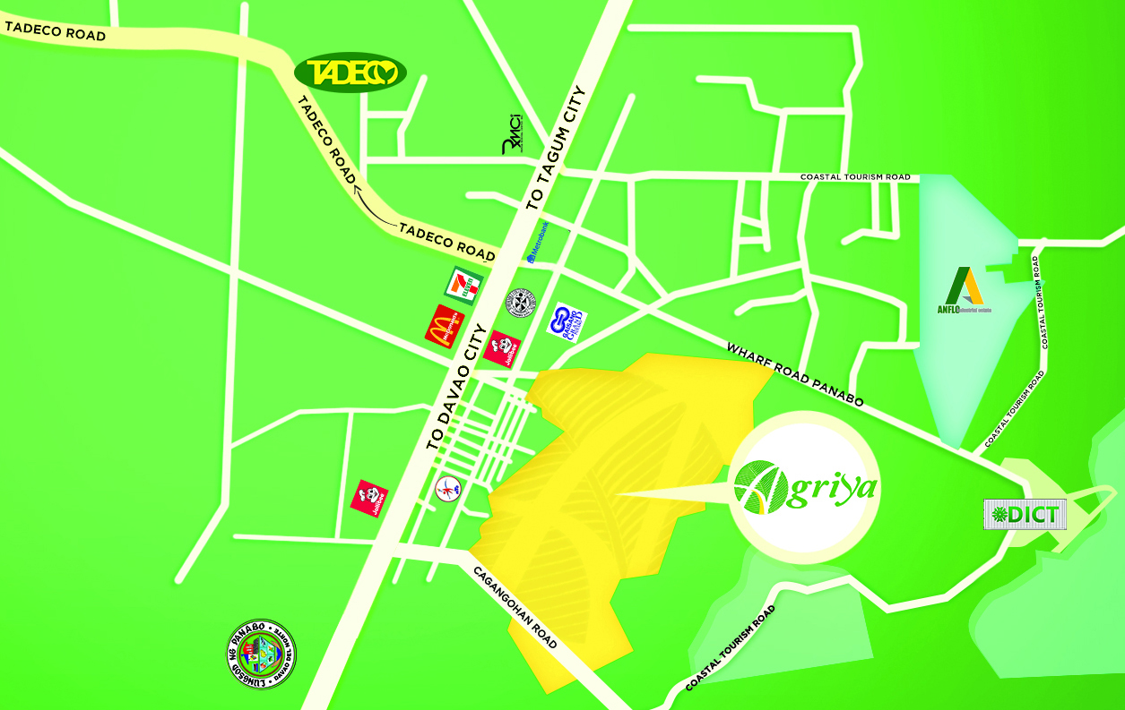




LOCATION
FOR TRAINING PURPOSES ONLY
Pass-through traffic: from Davao to Tagum, Davao Oriental, Butuan. The city is physically located between two economic hubs: Davao City (32km to the south) and Tagum (28km to the north).
Distance from Key Landmarks
Francisco Bangoy International Airport - 21.9 km
Daang Maharlika Highway - 1.0 km
Public Market/Gaisan Grand - 1.7 km
Panabo City Hall - 2.3 km
Maryknoll College of Panabo - 2.2 km
Rivera Medical Center - 2.7 km
Panabo Bus Terminal - 1.0 km
Access Roads:
  Quirino Street
  Garcia Street
  Coastal Road

Slide 4
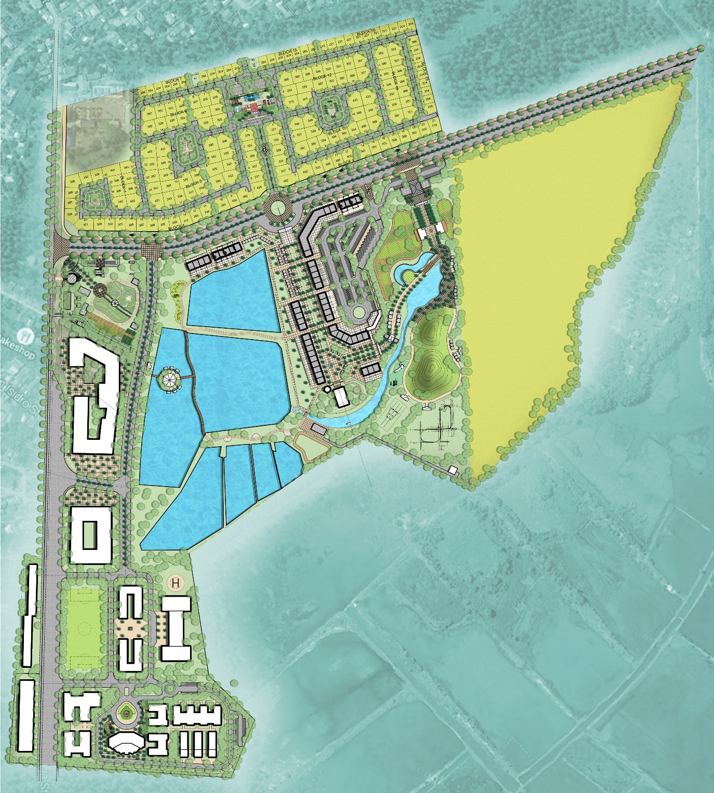
SITE DEVELOPMENT PLAN
FOR TRAINING PURPOSES ONLY
PHASE 1 Development
  Ameria (Residential Village)
  Naturetainment - Showcase
Farming Zone
Activity Zone
  UP Professional School for Agriculture and the Environment - Building 1
PHASE 2 Development
  Commercial Locators
  Naturetainment – Full Park
  Commercial Arcade
1
1
RESIDENTIAL
5
2
NATURETAINMENT
2
INTERIM
3
6
COMMERCIAL
4
4
5
6
INSTITUTIONAL
3

Slide 5

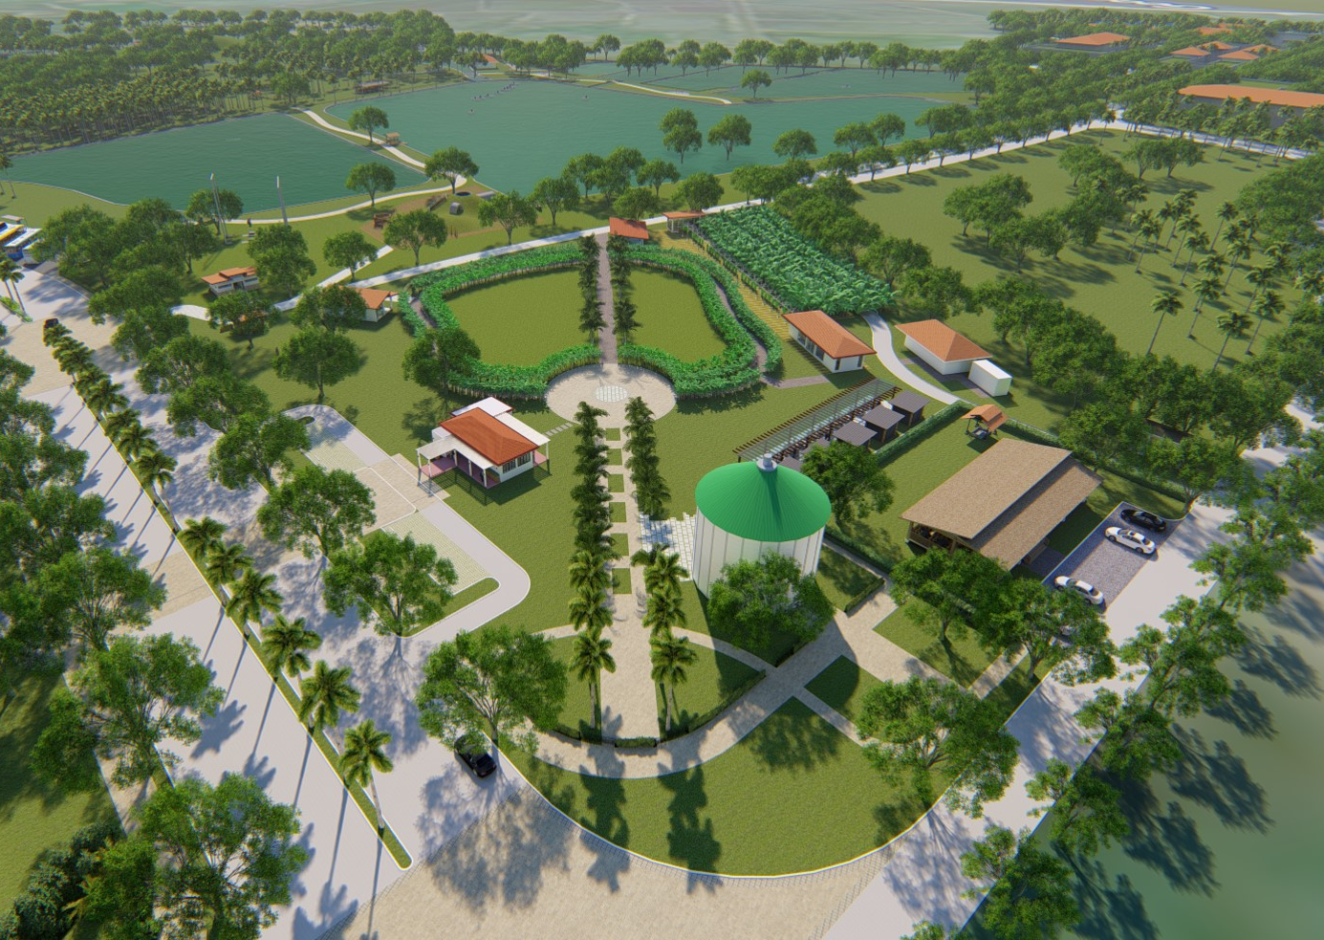
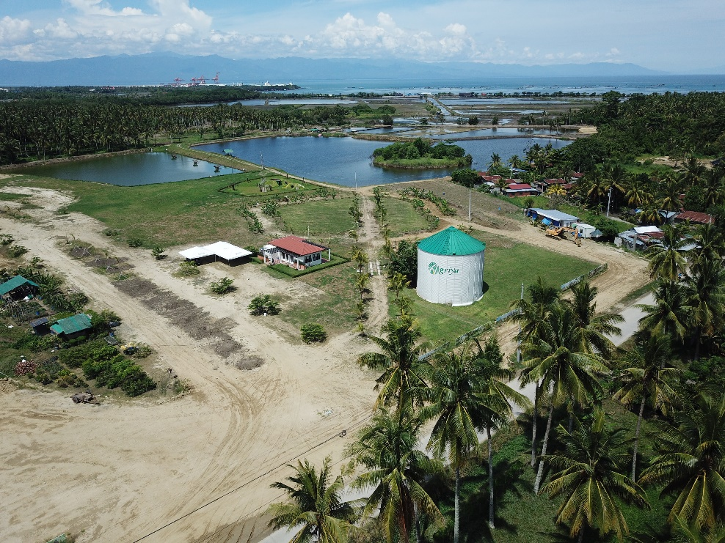

Slide 6


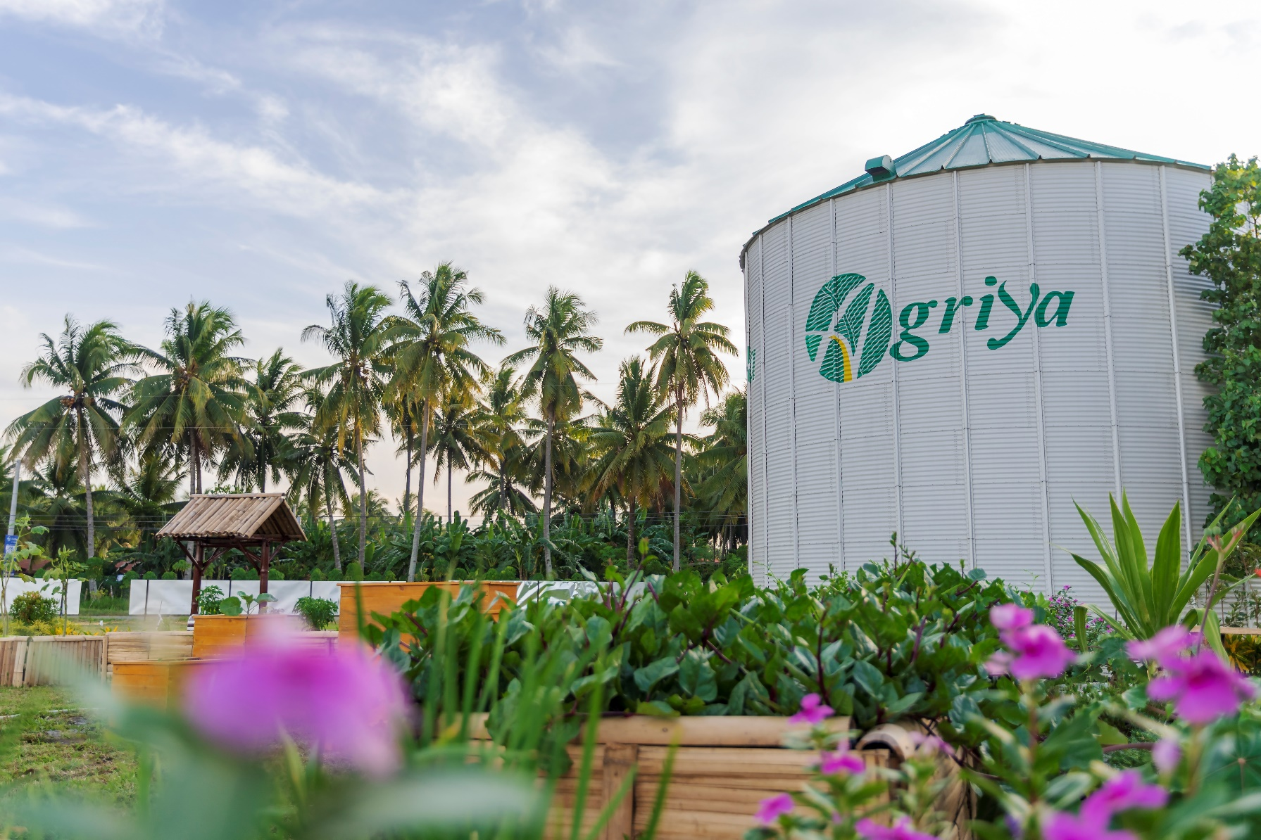

FOR TRAINING PURPOSES ONLY
SILO
  Farm Stand
  Restaurant
  Museum

Slide 7

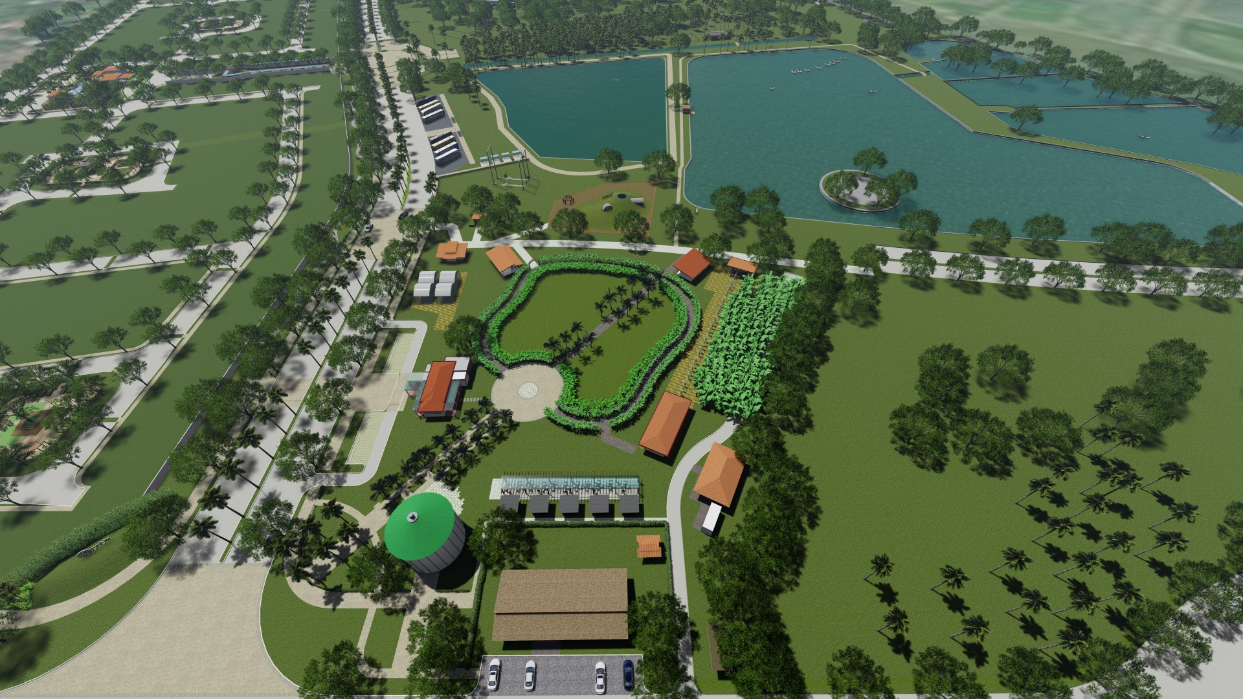
FOR TRAINING PURPOSES ONLY
FARM EXPERIENCE
AQUA CULTURE
AQUA FUN
REAL THRILL
GREENHOUSE NURSERY
AMUSA
EXPERIENCE
PICK & PAY
FOOD GARDEN
SILO

Slide 8

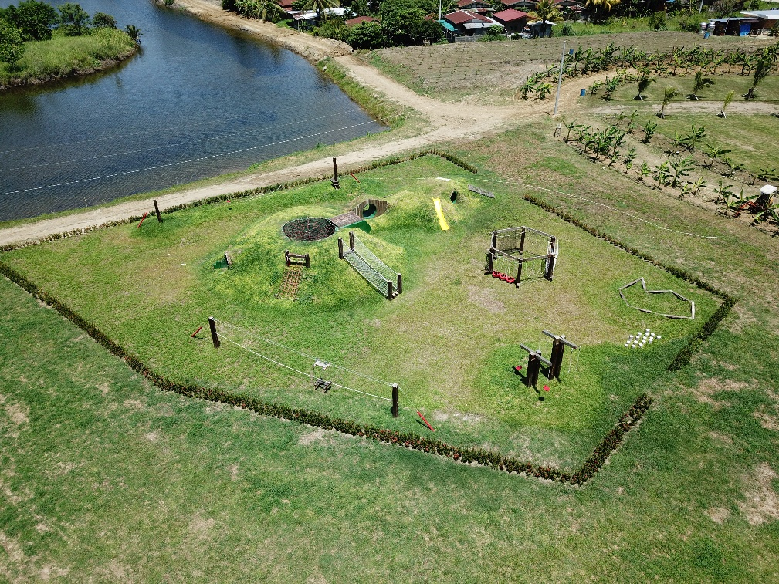


FOR TRAINING PURPOSES ONLY
EARTHMOUND
Chair Zip Line
Reverse Swing
Sand Pit

Slide 9
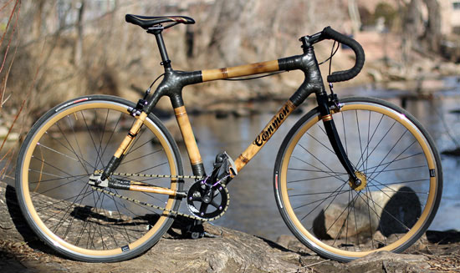
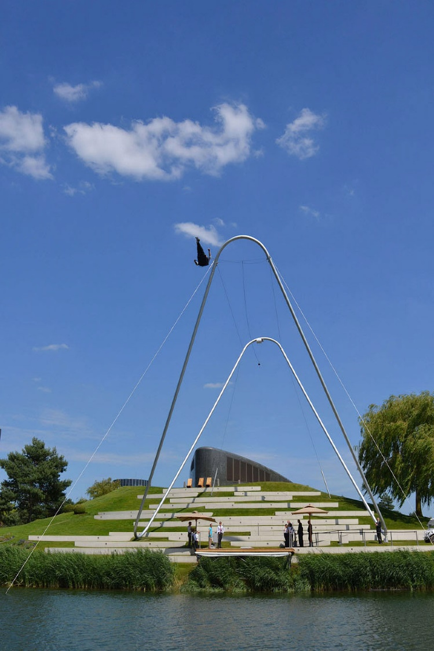
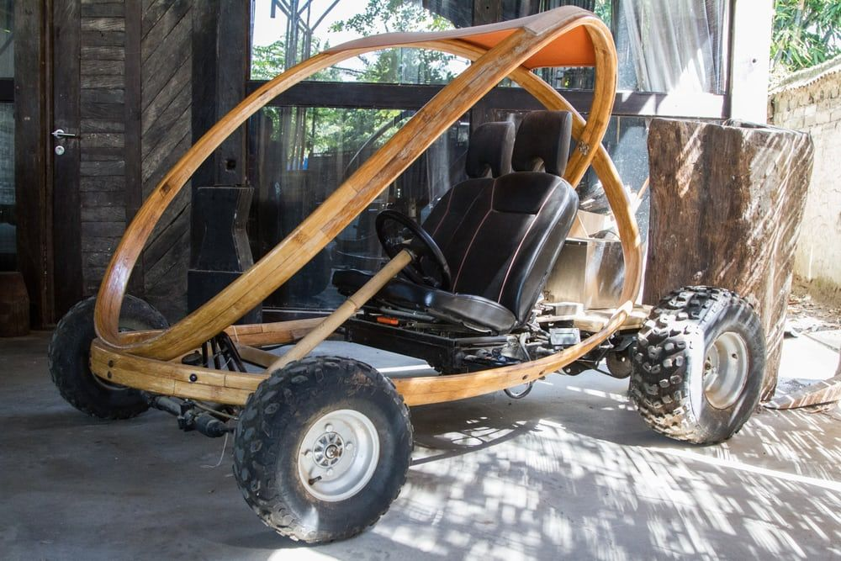
FOR TRAINING PURPOSES ONLY
REAL THRILL
  Giant Swing
  Bike Path
  Electric Go Kart

Slide 10
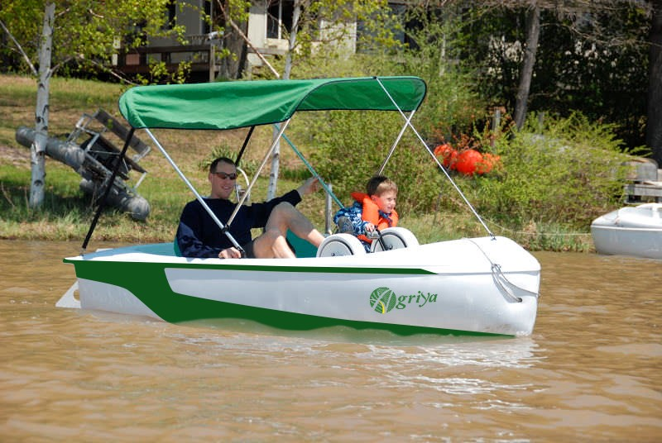
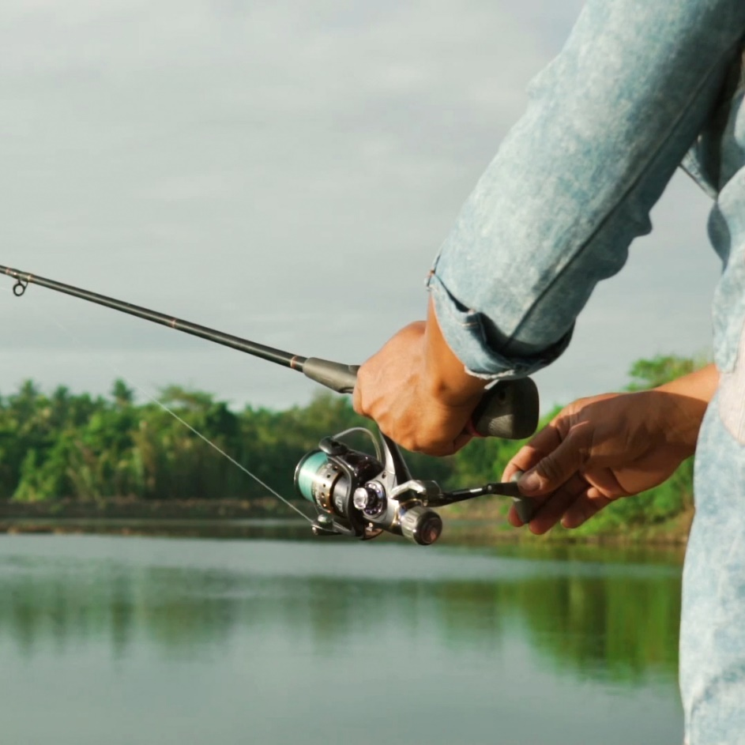
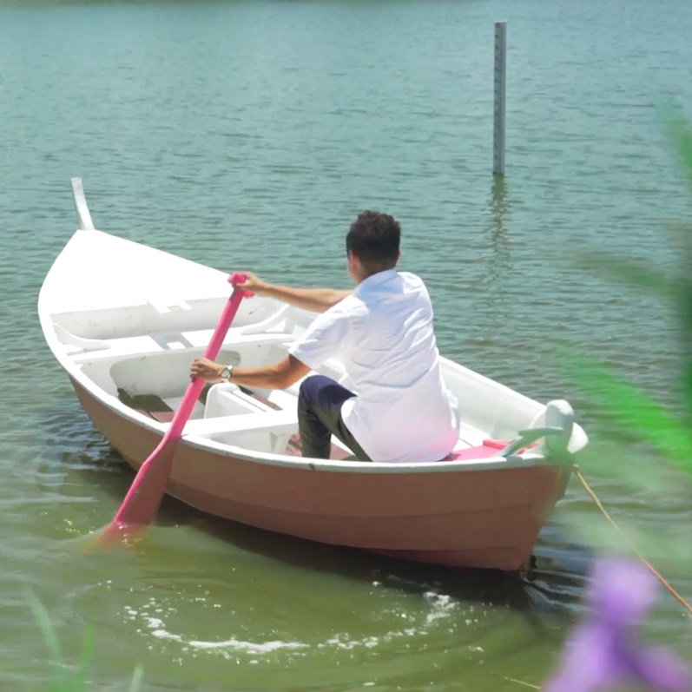
FOR TRAINING PURPOSES ONLY
AQUA FUN
  Boating
  Fishing
  Pedal Boat

Slide 11
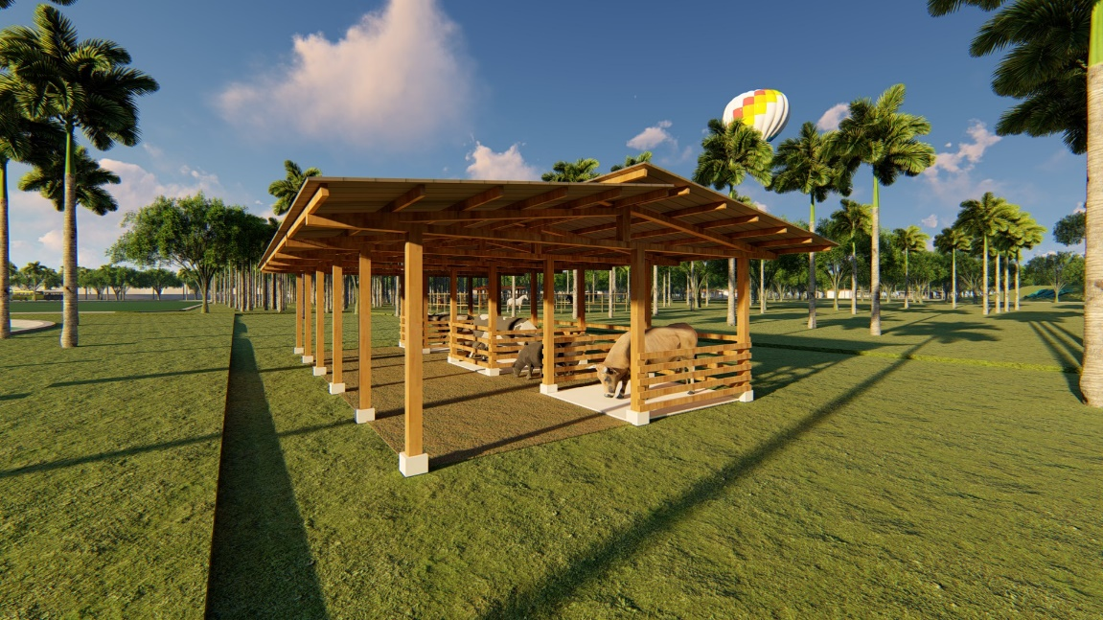
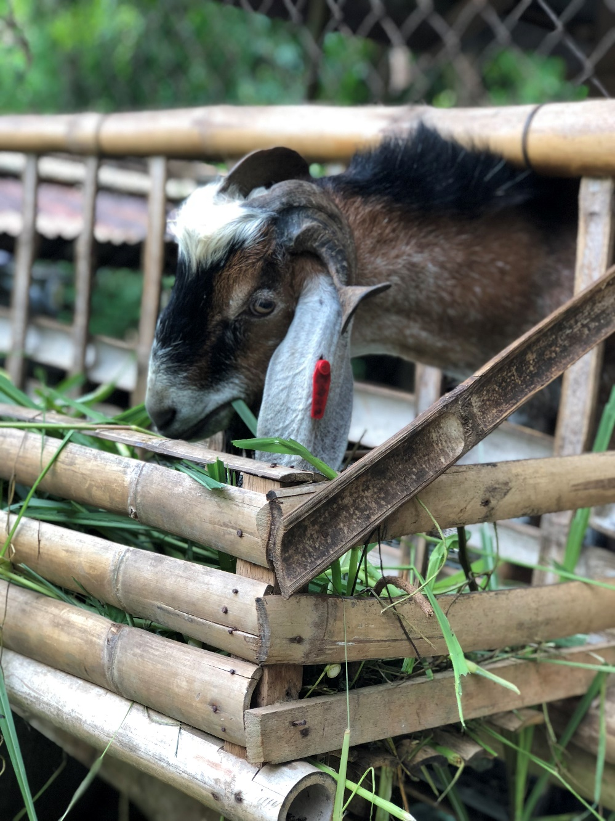
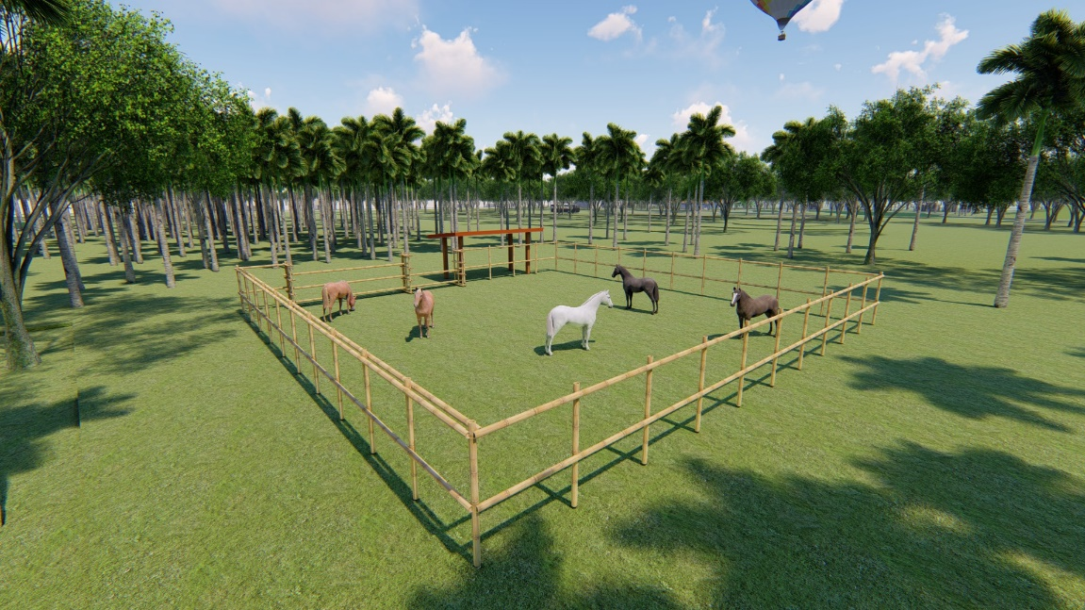
FOR TRAINING PURPOSES ONLY
FARM EXPERIENCE

Slide 12
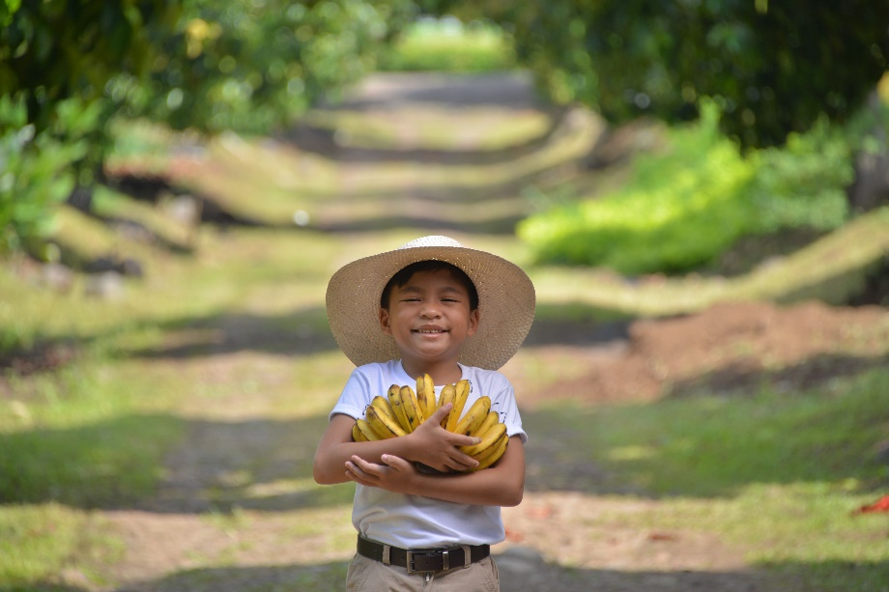
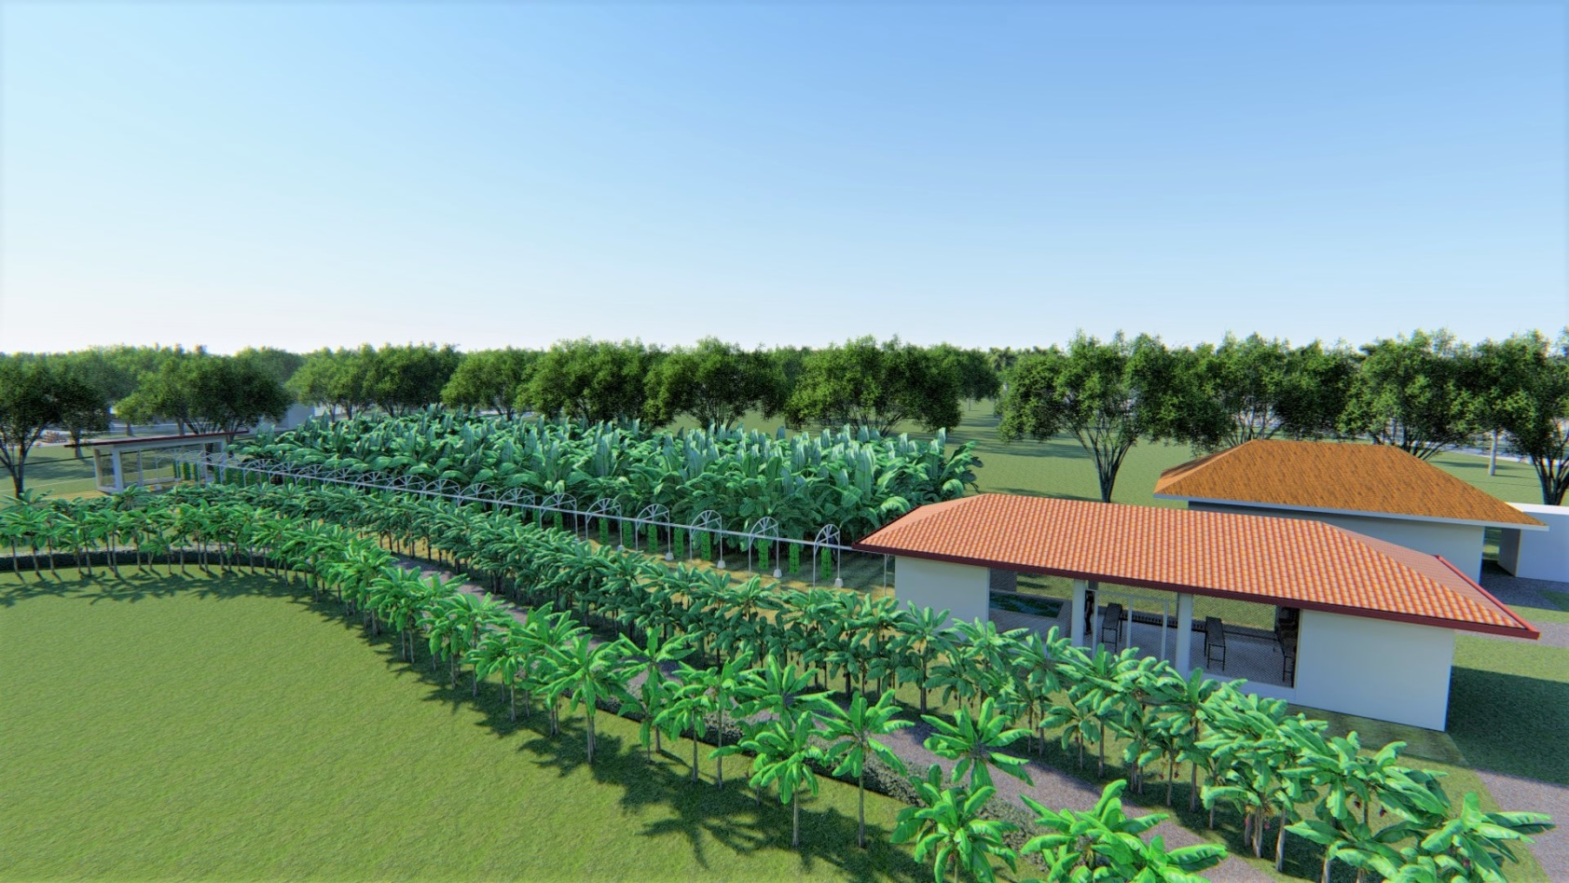
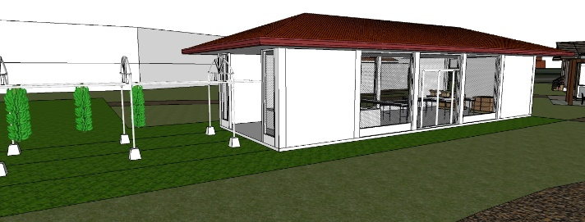
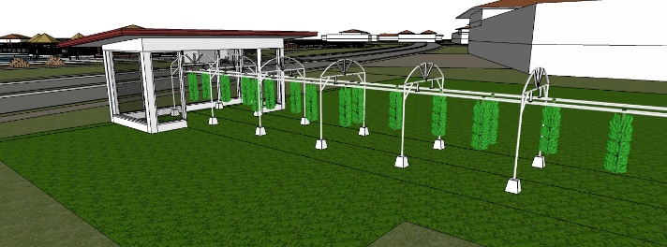
FOR TRAINING PURPOSES ONLY
AMUSA EXPERIENCE

Slide 13

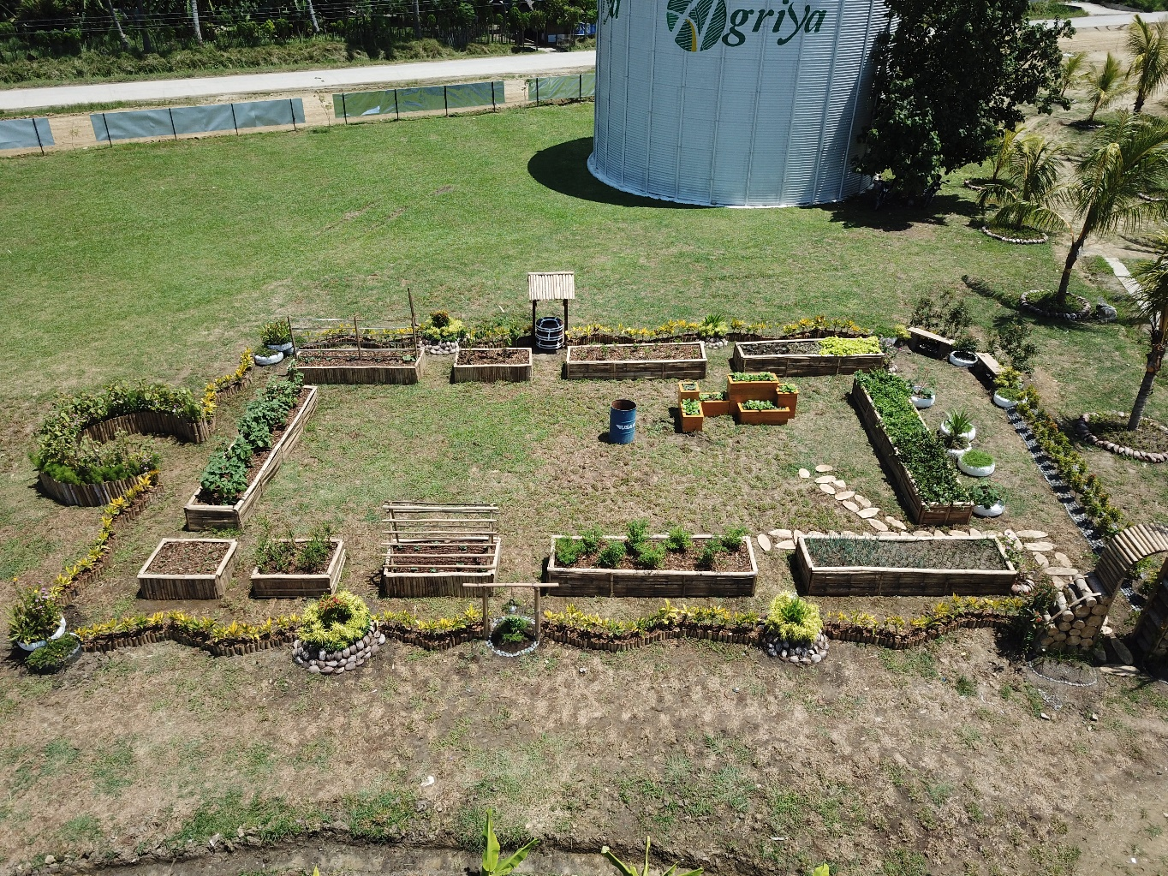
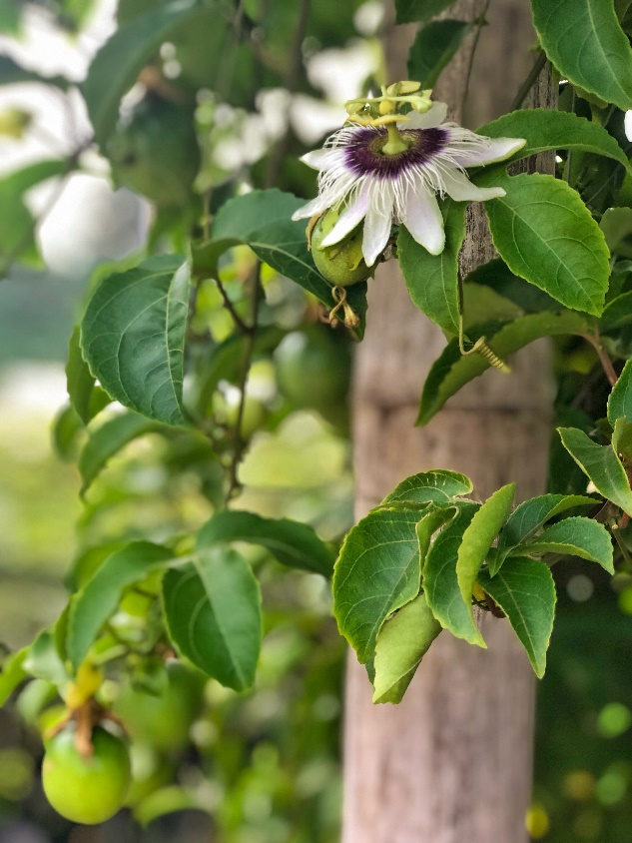
FOR TRAINING PURPOSES ONLY
FOR TRAINING PURPOSES ONLY
PICK & PAY

Slide 14
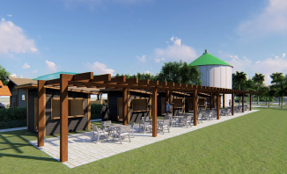
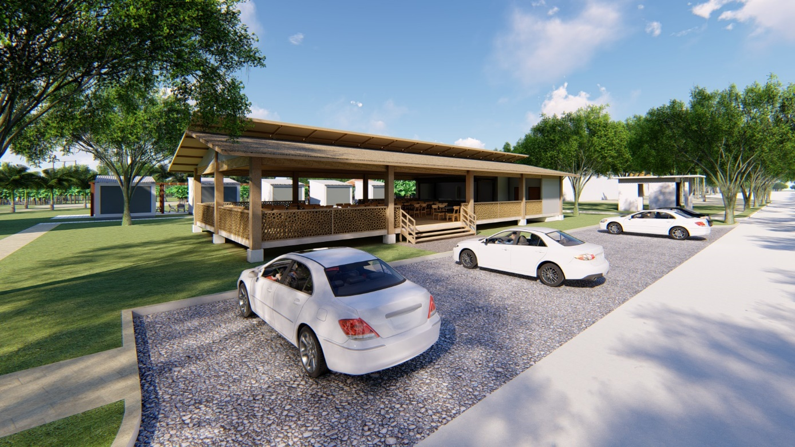
FOR TRAINING PURPOSES ONLY
FOOD GARDEN
RESTAURANT

Slide 15


FOR TRAINING PURPOSES ONLY

Slide 16
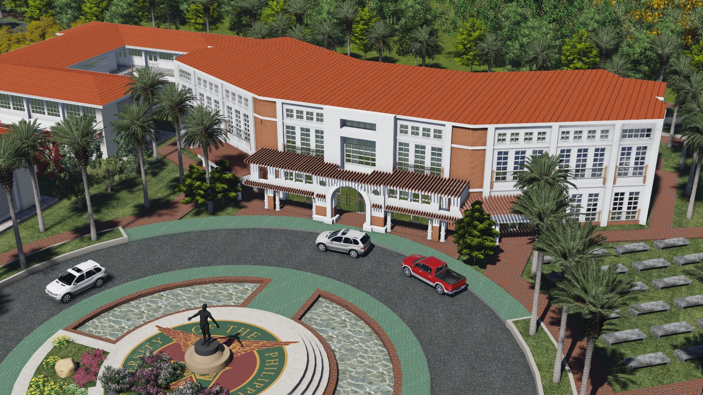


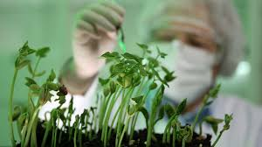
AERIAL PERSPECTIVE artist’s rendering
FOR TRAINING PURPOSES ONLY
University of the Philippines Professional School for Agriculture and the Environment
A PUBLIC-PRIVATE-PARTNERSHIP between Damosa Land, ANFLOCOR and University of the Philippines Los Banos.
The Memorandum of Agreement was signed last January 30, 2017.

